Slide 1

DATA SCIENCE CONSULTING Session 2
January 15th, 2019

Slide 2

Agenda
Review of progress made
Introduction to XPath
Scraping with Scrapy
API’s at a glance
Introduction to Business Case
Summary of the session
For next week...

Slide 3



Presentation of the achievements so far
10’
Restitution by 1 group of the data scraped using ParseHub

Slide 4


Reminder: Objectives & methodology for our case study
Identification of the themes and priorities per location to make Center Parcs a favorite holiday place in Europe
Objectives
Next Steps
Use data science to identify the priorities to improve Center Parcs places, from reviews on the Web
Scraping
Cleansing & feature engineering
Data analysis
Creating the final deliverable

Slide 5
Agenda
Review of progress made
Introduction to XPath
Scraping with Scrapy
API’s at a glance
Introduction to Business Case
Summary of the session
For next week...

Slide 6

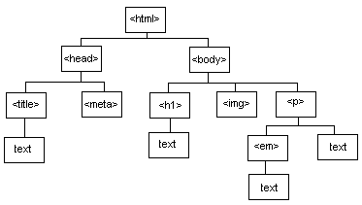
Introduction to XPath
What is XPath ?
A programing language, for requests
An easy language to select nodes in a document (XML)
XPath relies on the tree structure of HTML pages
Reminder: HTML is a markup language with a tree structure. XPath allows you to select:
Content of a markup
Content of its atributes (hypertext links for example)

Slide 7
Introduction to XPath
What is XPath ?
Xpath describes the path to a specific node:
From the root of the document and goes down
You can have several paths to the same node
A path can select several values
Tree
<AAA>
<BBB/>
<CCC/> <BBB/> <DDD> <BBB>
</DDD>
<CCC/>
Path
/AAA selects values after AAA /AAA/CCC selects values after CCC /AAA/DDD/BBB selects values after BBB

Slide 8
Introduction to XPath
4 basics operators
/ | Child
// | Descendant
@ | Atribute
[ ] | Condition
XPath | Action
//a | Every hypertext links
//div/a | Every hypertext links in a div
//a[contains(text(), ‘Dr.’)] | Every hypertext links where the text contains « Dr. »

Slide 9
Introduction to XPath
How to select
Atributes: @
If you want to extract a specific atribute, for example href which gives the URL to which is
pointing a link, you add /@href at the end of your path
Example
//a extracts all the nodes of links (markups, atributes, content)
//a/@href extracts only URL of all links

Slide 10
Introduction to XPath
How to select
Conditions: [ ]
Use conditions when you want to select nodes of a specific type
Example
//div[@class = "books"] extracts all the div of the class « book »
//a[contains(text(), "Dr.")] extracts all the links with the text « Dr. »
//a[contains(@href, "Harry")] extracts all the links whose adresses contains « Harry ».

Slide 11

Introduction to XPath
Tips
Don’t forget…to cheat ! Practising is the key, and there is a lot of resources on the web to help you:
Use cheat sheets
Use browser’s extensions such as Firepath (for Firefox), Xpath Wizard (for Google Chrome), SelectorGadget
Useful resources:
Tutorial on W3School: https://www.w3schools.com/xml/xpath_intro.asp
Another tutorial: http://zvon.org/comp/r/tut-XPath_1.html#intro

Slide 12
Agenda
Review of progress made
Introduction to XPath
Scraping with Scrapy
API’s at a glance
Introduction to Business Case
Summary of the session
For next week...

Slide 13

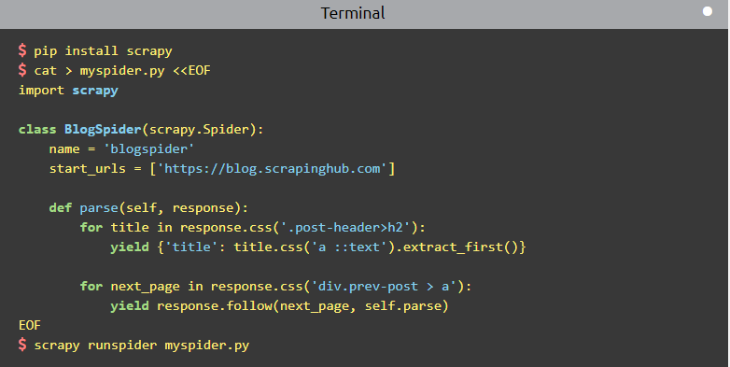
Scraping with Scrapy
Scrapy is a powerful Python package to scrape, an application framework for writing web spiders that crawl web sites and extract data from them.
It combines a crawler and a parser, so it’s pretty complete for a
scraping project.
First step: install Scrapy using
pip install scrapy
or, if you’re using Anaconda:
conda install -c conda-forge scrapy

Slide 14
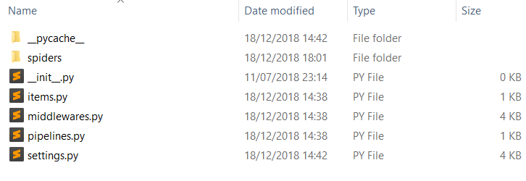

Scraping with Scrapy: Spiders
Create a new project with the command line:
scrapy startproject project_name
This will create a directory with different files and subfolders:
Scrapy works with spiders, which are classes that you define and that Scrapy uses to scrape information from a website (or a group of website).
They must define the initial requests to make, optionally how to follow links on pages, and how to parse the downloaded page content to extract data.
You can write a spider inside a .py script, or you can use Jupyter’s notebook.

Slide 15

Hands-on 1: Scrapy
15’
Explore the 1st notebook and explain what it does

Slide 16

Hands-on 1: Scrapy
5’
Restitution by 1 group

Slide 17
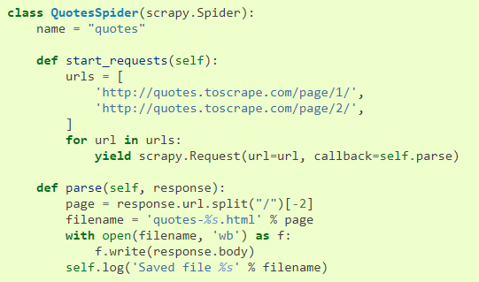

Scraping with Scrapy: Spiders
We define our spider with the subclass scrapy.Spider, and defines some attributes and methods:
name: identifies the Spider, must be unique within a project
start_requests(): must return an iterable of Requests which the Spider will begin to crawl from.
parse(): method that will be called to handle the response downloaded for each of the requests made.
The parse()method usually parses the response, extracting the scraped data as dicts and finding new URLs to follow and creating new requests from them.
TIPS: As you may have noticed in the first notebook, you can just define a start_urls class attribute with a list of URLs instead of defining a start_requests() method.

Slide 18

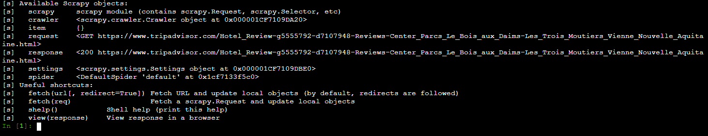
Scraping with Scrapy: Shell and Selectors
Exploring a website
Scrapy uses its own mechanism to parse pages, called Selectors, based on lxml, a Python XML parser. The best way to learn how to extract data with Selectors is to use the Scrapy shell.
You can launch the Scrapy shell using
scrapy shell ‘url_to_explore’
You should see something like this:

Slide 19

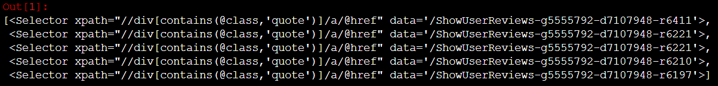
Scraping with Scrapy: Shell and Selectors
You can use the Shell to select elements using CSS or XPath with the response object.
For example, on TripAdvisor, you can select reviews’ URLs using:
response.xpath("//div[contains(@class,'quote')]/a/@href")
which gives the following output:
This output is a list-like object called SelectorList, which represents a list of Selector objects you can extract.
More information on Scrapy’s selectors: https://docs.scrapy.org/en/latest/topics/selectors.html#topics-selectors

Slide 20



Scraping with Scrapy: Storing data
The easiest way to store your scraped data is by using Feed exports, with the following command:
scrapy crawl spider_name –o file.json
Saving your data using the JSON format will only work once, since Scrapy will append to a given file instead of overwriting its contents. If you run the command twice without deleting the file before the second time, you’ll end up with a broken JSON file.
You can also use JSON Lines format (file.jl) instead, which doesn’t have the same problem of JSON if you run twice.

Slide 21
Hands-on 2: Scrapy
45’
Use the 2nd notebook to scrape one page of TripAdvisor’s comments

Slide 22
Hands-on 1: Scrapy
5’
Restitution by 1 group

Slide 23
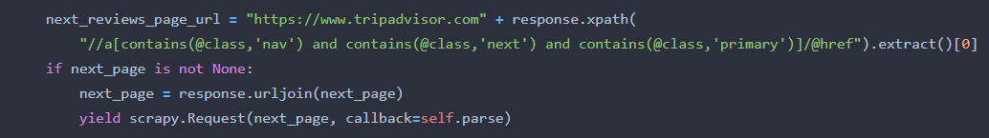
Scraping with Scrapy: Crawling
Now that you know how to extract data from one page, we need to see how to follow links
from one page to another, so that you’ll be able to scrape a full website on your own !
Crawling using Scrapy is made of 3 steps:
Identiyfing the link you want to follow with Selectors in the Scrapy Shell (or using tools like SelectorGadget…)
Extracting this link using the .extract() method
Modify the spider to follow the extracted link by adding it to your parse()method:

Slide 24
Scraping with Scrapy: Crawling
What just happened ?
The parse() method looks for the link to the next page, builds a full absolute URL using the urljoin() method (since the links can be relative) and yields a new request to the next page registering itself as callback to handle the data extraction for the next page and to keep the crawling going through all the pages.
When you yield a Request in a callback method, Scrapy will schedule that request to be sent and register a callback method to be executed when that request finishes.
Using these principles, you can build yourself powerful crawlers that will follow links according to rules you define

Slide 25
Hands-on 3: Crawling with Scrapy
45’
Use the 3rd notebook to scrape TripAdvisor’s comments on Center Parcs

Slide 26
Hands-on 3: Scrapy
5’
Restitution by 1 group

Slide 27
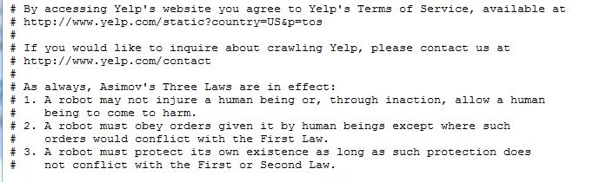
Scraping web pages
A few tips
Often the information you’d like to extract is contained across multiple pages, so you will need to understand the pattern according to which the URL addresses are built, in order to create a list of the URL to parse.
Some websites have robots alarm and block access when you perform too many requests in a given time interval. To avoid this problem, you can import the “time” Python module and make your program stop a few seconds in between requests.
Some websites have a robot.txt file in which you can find their robots policy :
Example: type http://yelp.com/robots.txt
Add some “try and except” in your code: sometimes, the parsing can return an error due to some irregularities in the objects you parse. Adding some try and except will enable your code to keep running even though some piece of information could not be extracted for one reason or another

Slide 28
Agenda
Review of progress made
Introduction to XPath
Scraping with Scrapy
API’s at a glance
Introduction to Business Case
Summary of the session
For next week...

Slide 29
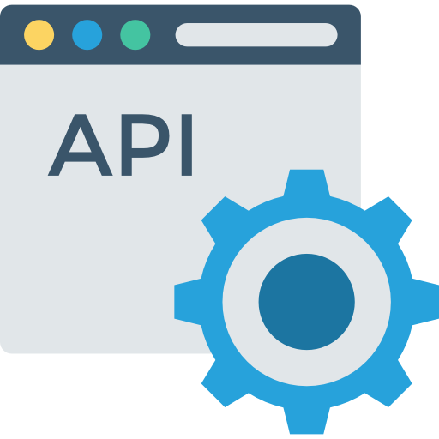
APIs at a glance
A particular website provides information you are interested in and you would like to be able to retrieve this information in a structured format? Then you should look if the website has an API
In fact, many websites and web services now provide APIs (application programming interfaces)
APIs allow you to send data request in a structured format
The advantage of using API (when they are available) is that they involve less programming

Slide 30
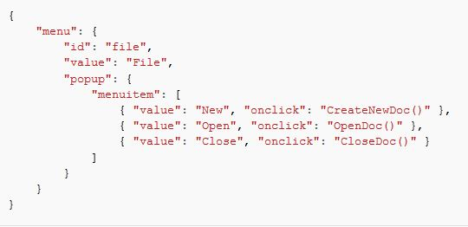
Using APIs: Language of the query
The data you request from a web API usually comes in a string format, and JSON (JavaScript Object Notation) and XML are the two most common languages for the output of API queries
A minimal familiarity with one of these languages can be useful when you want to structure the output of the queries into a processable dataset
You can often choose the language of the query results among the available options
JSON can be parsed using Python’s json module and you can easily get around with JSON objects if you are familiar with Python dictionaries

Slide 31
Finding & using APIs
APIs availability
Authentication
Python wrapper
Many websites proposing APIs
Possibility to check the API and/or Developer sections of the website
Most APIs requiring authentication
Necessity to register to the website, to get the required API key
Useful when available, for request automation, structuration of queries’ outputs and data saving in desired formats

Slide 32




Top 8 social network APIs & policies
General policy – no web scraping but APIs available
No direct scraping unless authorized (fill in authorization form – 2 weeks for FB answer). Terms are at: https://www.facebook.com/apps/site_scraping_tos_terms.php
APIs exist for app developers
Limited collection of the data (speed/volume is compared to what « human can reasonably produce »), it allows read & write operations on videos with a limited quota
No personal data
No direct scraping
API with limited number of call by 15 min window
Prohibition of scraping software https://www.linkedin.com/help/linkedin/answer/56347/prohibition-of-scraping-software?lang=en (check internet news for their law suits)
APIs are for app development

Slide 33




Top 8 social network APIs & policies
General policy – no web scraping but APIs available
Access through API REST with a limited number of requests (10 to 1000 calls in a 1h-window)
No image storing (user permission - copyright)
The Google+ API currently provides read-only access to public data. All API calls require either an OAuth 2.0 token or an API key
Number of calls are limited
Access through API with Oauth using JS/Ruby/Php/Java/Python/Objective-C – limitations for the access frequency exist but not officially provided (“Respect for limitations” in License Agreement)
Sensitive to user content
The free API is for “non-automated” apps, user authorization needed, Python/Ruby versions exists, 5000 calls per hour, it is being depreciated in favor of the new “Business version” (Instagram Graph API)
Sensitive to user content/media (owned by users)

Slide 34
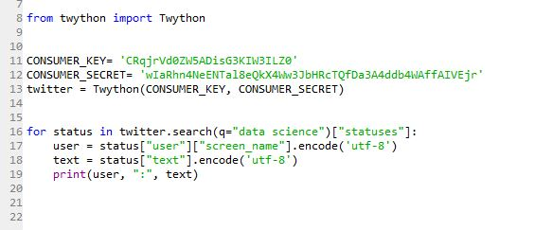
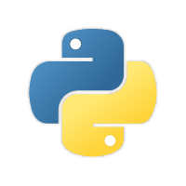
Using APIs: Twitter API
API authentication
For example, suppose we want to retrieve all the tweets related to data science in order to do text mining on them
There are several Python libraries for Twitter API, so we will be using “Twython” library.
First you need to register a Twitter account and ask for an API key

Slide 35
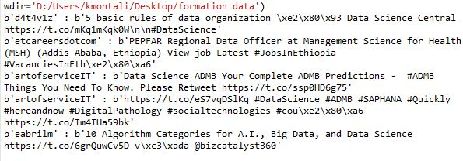
Using APIs: Twitter API
What do we get from the request ?

Slide 36
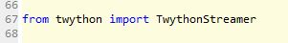
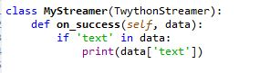
Using APIs: Twitter API
Look for more advanced features of the API in order to get more precise information
In this example, the request only gives you the most recent tweets related to the keywords “data science”
If you want to collect more tweets, you should connect to the Twitter stream and collect data.
The Streaming API enables you to do this
To access this functionality, you will need to ask for an access token
Use the TwythonStreamer class in Twython module
TwythonStreamer has a method called “on_success”, which defines when to retrieve a tweet
You can create a new class out of it in order to retrieve only tweets with a specific attribute

Slide 37
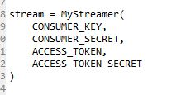
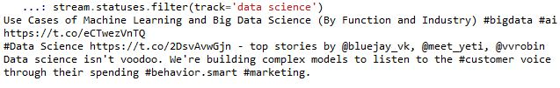
Using APIs: Twitter API
Enter you access token and authenticate yourself
Then use a status filter in order to track a particular term
This command will print a stream of tweets corresponding to the filter “data science”
Then you can store these tweets into the format of your choice and create a dataset

Slide 38
Agenda
Review of progress made
Introduction to XPath
Scraping with Scrapy
API’s at a glance
Introduction to Business Case
Summary of the session
For next week...

Slide 39

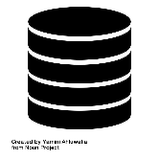



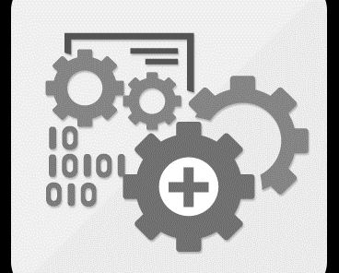

What is a data use case?
Business decision
In the context of a specific business process
Analytical solution
Outcomes
Big data technologies & capabilities
Actionable insights
Business value …
… measured with KPIS
Analytical approaches
Automated actions
End-user
Data sources
Iterative process

Slide 40





Examples of business decisions
Attribute the optimal price for my product
Select which prospects to target in priority
Select which recommendation to send to which customer
Define my maintenance & replacement plans
Determine which quantity of raw materials to buy, at which cost

Slide 41




Examples of applications
Competition monitoring (Strategy & Marketing teams) Determine strategic moves based on the analysis of product defaults for the company and its competitors
Consumer insights (Marketing teams) Select which products & services to propose, based on a better understanding of consumers
Aftersales optimization (Marketing & aftersales teams) Select automated and pro-active care actions to put in place, in order to resolve customer issues efficiently
Product development (Product development & technical teams) Determine the critical features for the next generation of products, based by understanding of consumer pain points & expectations

Slide 42

Methodology
Typical approach of a data project
Data science
Building & review of the analysis plan
Iterative running of the analyses
Data collection
Building of deliverable
Business
Understanding of the current situation (organization, technology etc.)
Alignment on an industrialization scenario & plan
Business case
Gouvernance
Legend:
Weekly status update
Steering Committee
Deliverables

Slide 43

Case study
Identification of the themes and priorities per location to make Center Parcs a favorite holiday place in Europe

Slide 44

Brainstorming in groups: Business decision
20’
What would be the potential business decisions for this use case?

Slide 45
Report-out: Business decision
5’
One speaker from one group presents Other groups to complete

Slide 46


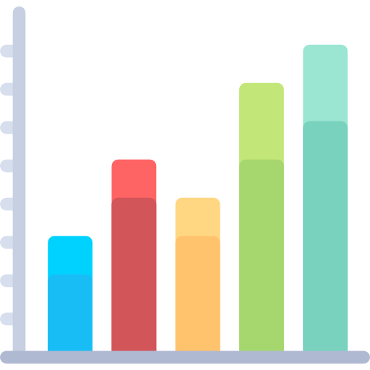
What is a business case
Estimation of the benefits of a transformation project…
… associated to an action plan validated by operational teams…
… showing impacts on the company’s financial performances…
… resulting in decisions taken by the client.

Slide 47

Why do we need a business case?
To create sense of urgency and stress the transformation needs
To convince and reinsure on the results of the transformation
To help deciding on project launch
To ensure engagement and interest in the project

Slide 48
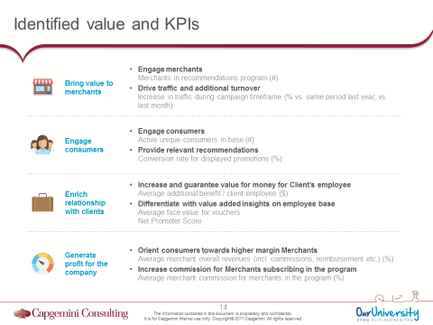
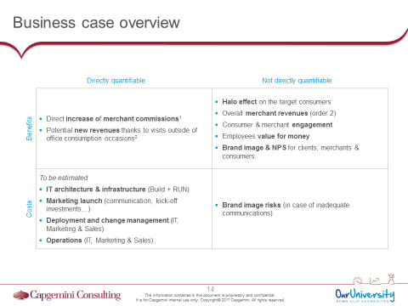
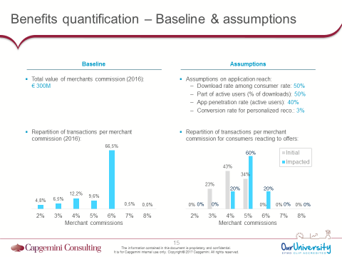
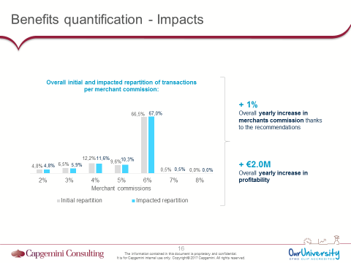
3 key deliverables
ILLUSTRATION
ILLUSTRATION
ILLUSTRATION
1. Identified value streams & associated KPIs
2. Benefits & costs matrix
3. Benefits & costs quantifications

Slide 49
Deliverable #1: Identified value stream and associated KPIs
ILLUSTRATION
Identification of the value brought the different stakeholders (internal and external) by the considered use case
1
2
1
For each of the stakeholders, finding of:
The impacts of the value brought
The KPIs enabling the measure them
2

Slide 50

Deliverable #2: Benefits and costs matrix
ILLUSTRATION
Identification of the directly quantifiable benefits and costs (e.g. additional sales in volume, cross / up-sell, implementation and roll-out costs…)
1
2
1
Identification of the benefits and costs that are not directly quantifiable (e.g. engagement, satisfaction, brand image, technological risks…)
2

Slide 51


Deliverable #3: Benefits and costs quantification
Baseline identification & quantification (modeling of as-is revenue / cost structures if nothing changes)
ILLUSTRATION
1
1
2
ILLUSTRATION
Impacts of the use case – assumptions and impacted baseline
3
2
Overall impacts on costs and revenues (difference between impacted baseline and initial baseline)
3

Slide 52
Hands-on: Value & KPIs and benefits & costs matrix
30’
Identify the value generated by this use case (for aftersales) and associated KPIs
Fill-in the benefits & costs matrix for this use case

Slide 53



Identified value and KPIs
Xxx
Xxx Xxx
Xxx Xxx
Xxx
Xxx Xxx
Xxx Xxx
Xxx
Xxx Xxx
Xxx Xxx

Slide 54
Example: Benefits & cost matrix
Not directly quantifiable
Directly quantifiable
Benefits
XXX | XXX
XXX | XXX
Costs

Slide 55
Report-out: Business decision
5’
One speaker from one of the 4 groups Other groups to complete

Slide 56
Agenda
Review of progress made
Introduction to XPath
Scraping with Scrapy
API’s at a glance
Introduction to Business Case
Summary of the session
For next week...

Slide 57

Today we learnt…
Web Scraping
Business decisions
Know how to write XPath requests…
…and how to explore the HTML tree with several tools (SelectorGadget, Xpath helper…)
Use Scrapy with Python to scrape a website by writing a spider capable of both crawling and parsing
Know about the existence of APIs and how to use them (with the help of their documentation)
Know what is a business case
… and how is it linked to business decisions
Understand the reasons why you need business decisions
Know the main deliverables

Slide 58
Agenda
Review of progress made
Introduction to XPath
Scraping with Scrapy
API’s at a glance
Introduction to Business Case
Summary of the session
For next week...

Slide 59

Work for next week
Instructions
Gather as much as possible data using Scrapy on websites with comments on Center Parcs
Put all data in a single dataframe

Slide 60
THANK YOU!

